Slide 1
Sun Buddy (~1)
By: CJ Jorgenson, Jaselyn Walker, Caitlyn Irwin, Sadie Angell, Sharlie Jones, and Sophia Beebe
Notes:
Each person introduces themselves
Caitlyn: Intro to the presentation

Slide 2


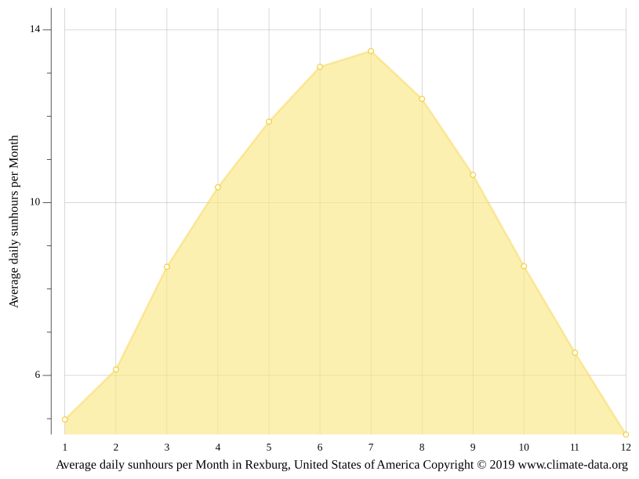
Rexburg
Notes:
Sadie: Rexburg Population
Sharlie: Stress
How many of you have stress?
Stress increases in the winter

Slide 3


Development (Ideate)
How can we help Rexburg community members to get enough sunlight despite the cold weather and shortened daylight of winter?
How can we creatively use the emerging opportunities AI offers?
Notes:
Jaselyn: From the time we spent empathizing and discovering Rexburgs residents increased stress in the winter. We realized that while getting more sunlight would help with this problem, the cold weather and increased hours of sunlight make it difficult. So that led us to consider these questions
Sophia:

Slide 4
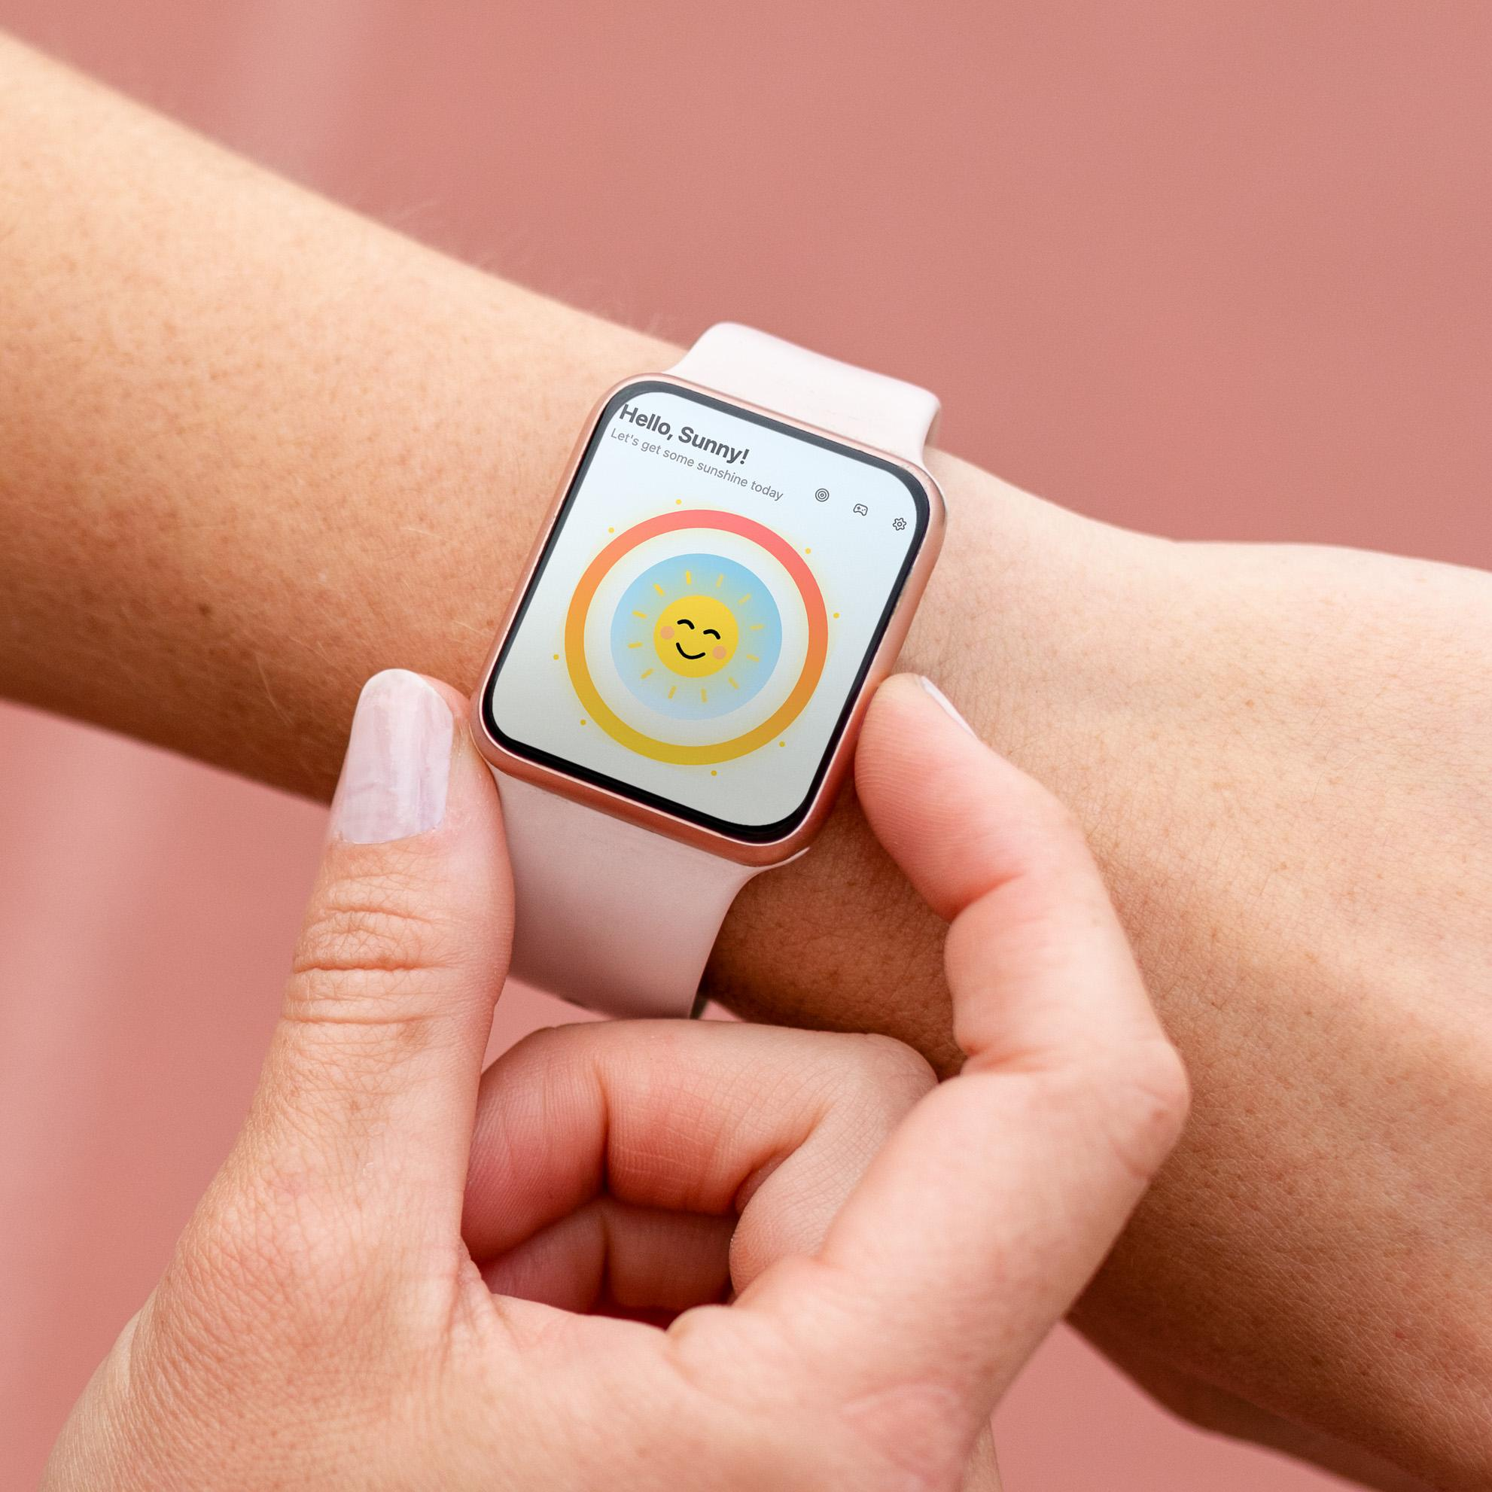

Notes:
Caitlyn: Start to segway from Base44
CJ: Avatar Customization
Sharlie: Fun Facts
Jaselyn: Tracking Sunlight
Sadie: Social Community Page
Sophia: Goals/Biometrics
Caitlyn: - Game

Slide 5
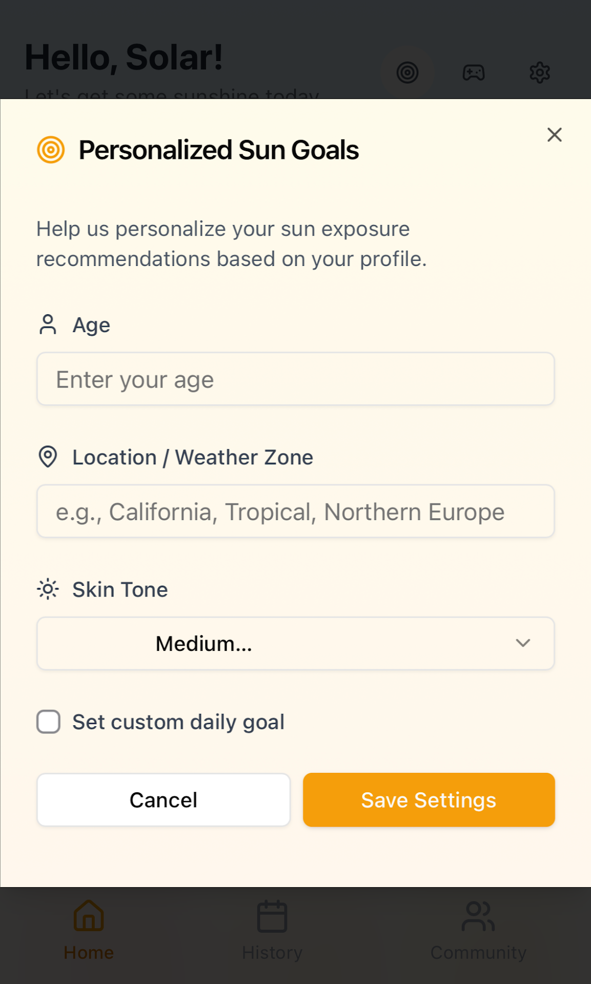
Goal Creation:
Notes:
Sophia: Goals/Biometrics

Slide 6
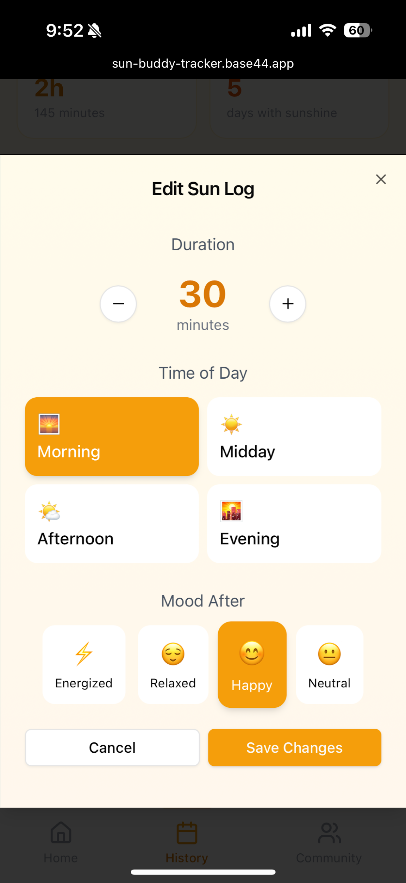
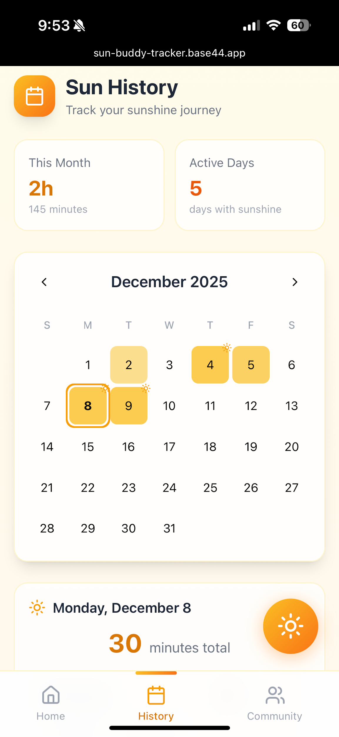
Tracking Sunlight
Intake:
Notes:
Jaselyn: Tracking Sunlight (Sun avatar changes as intake increases

Slide 7
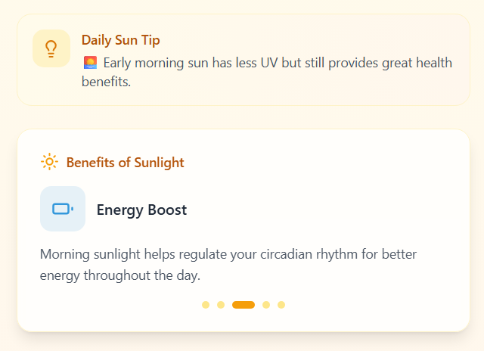
Fun Facts (Daily Sun Tip)
Notes:
Sharlie: Fun Facts

Slide 8
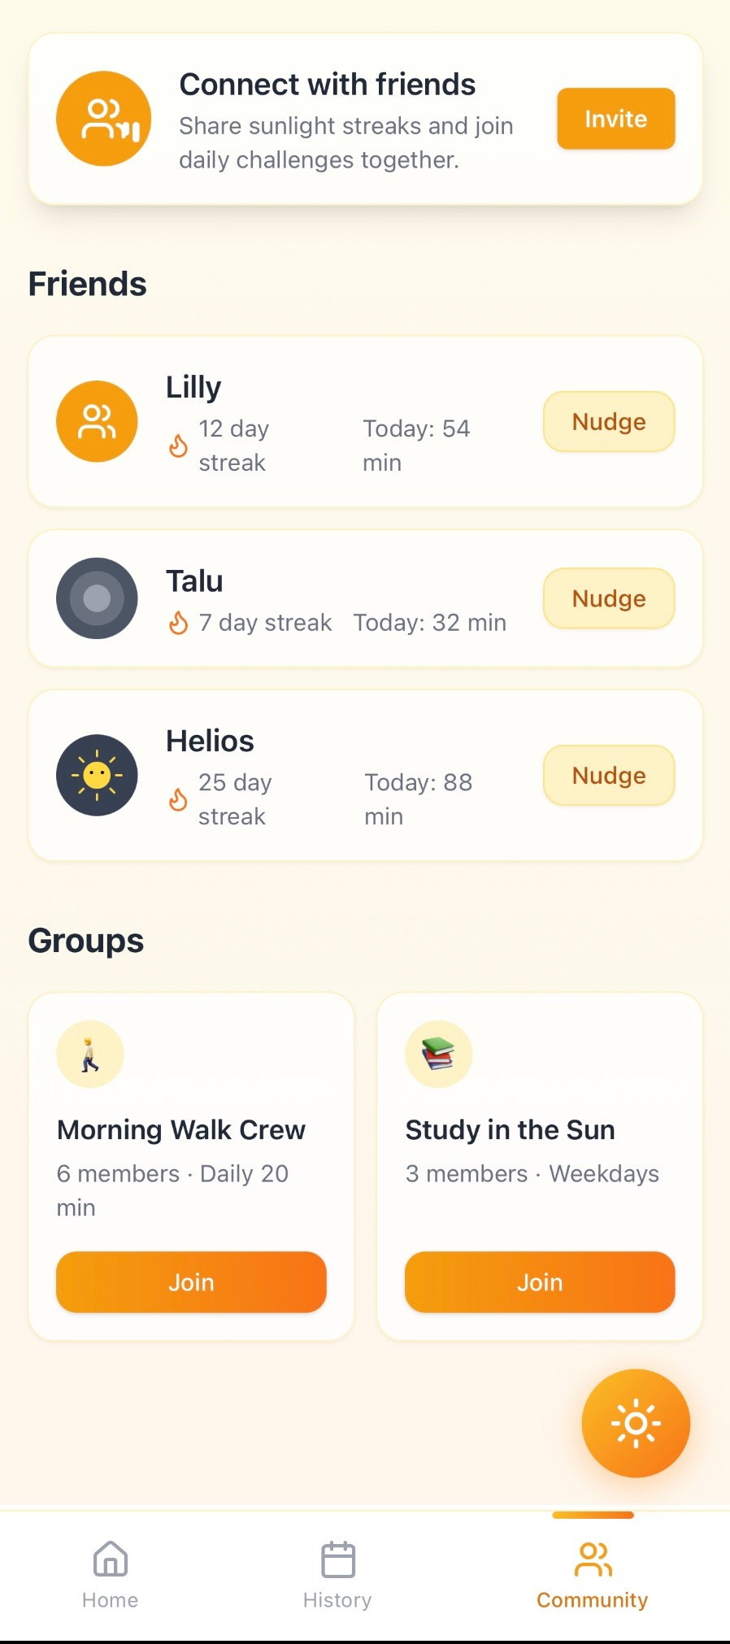
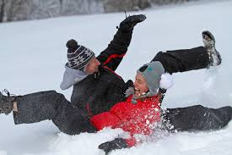
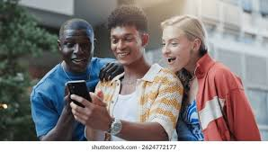
Social Networking
Notes:
Sadie: Social Community Page

Slide 9
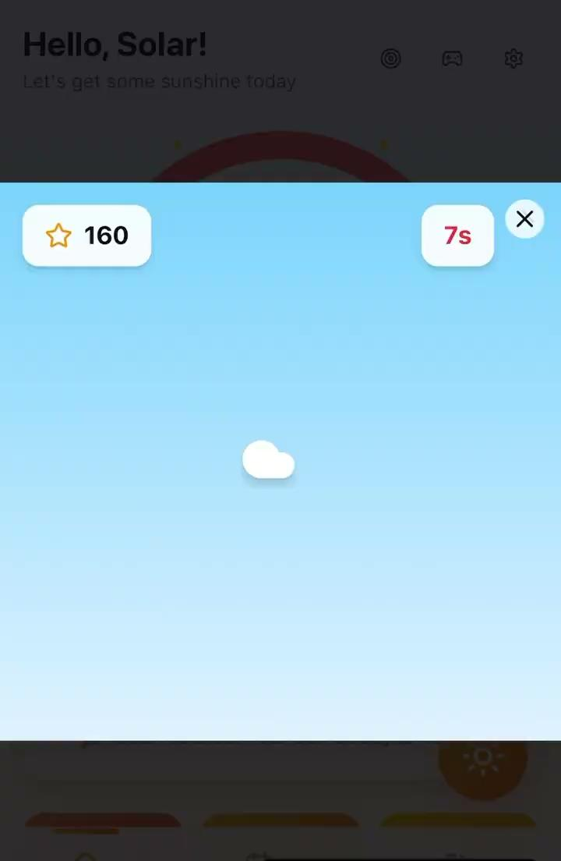
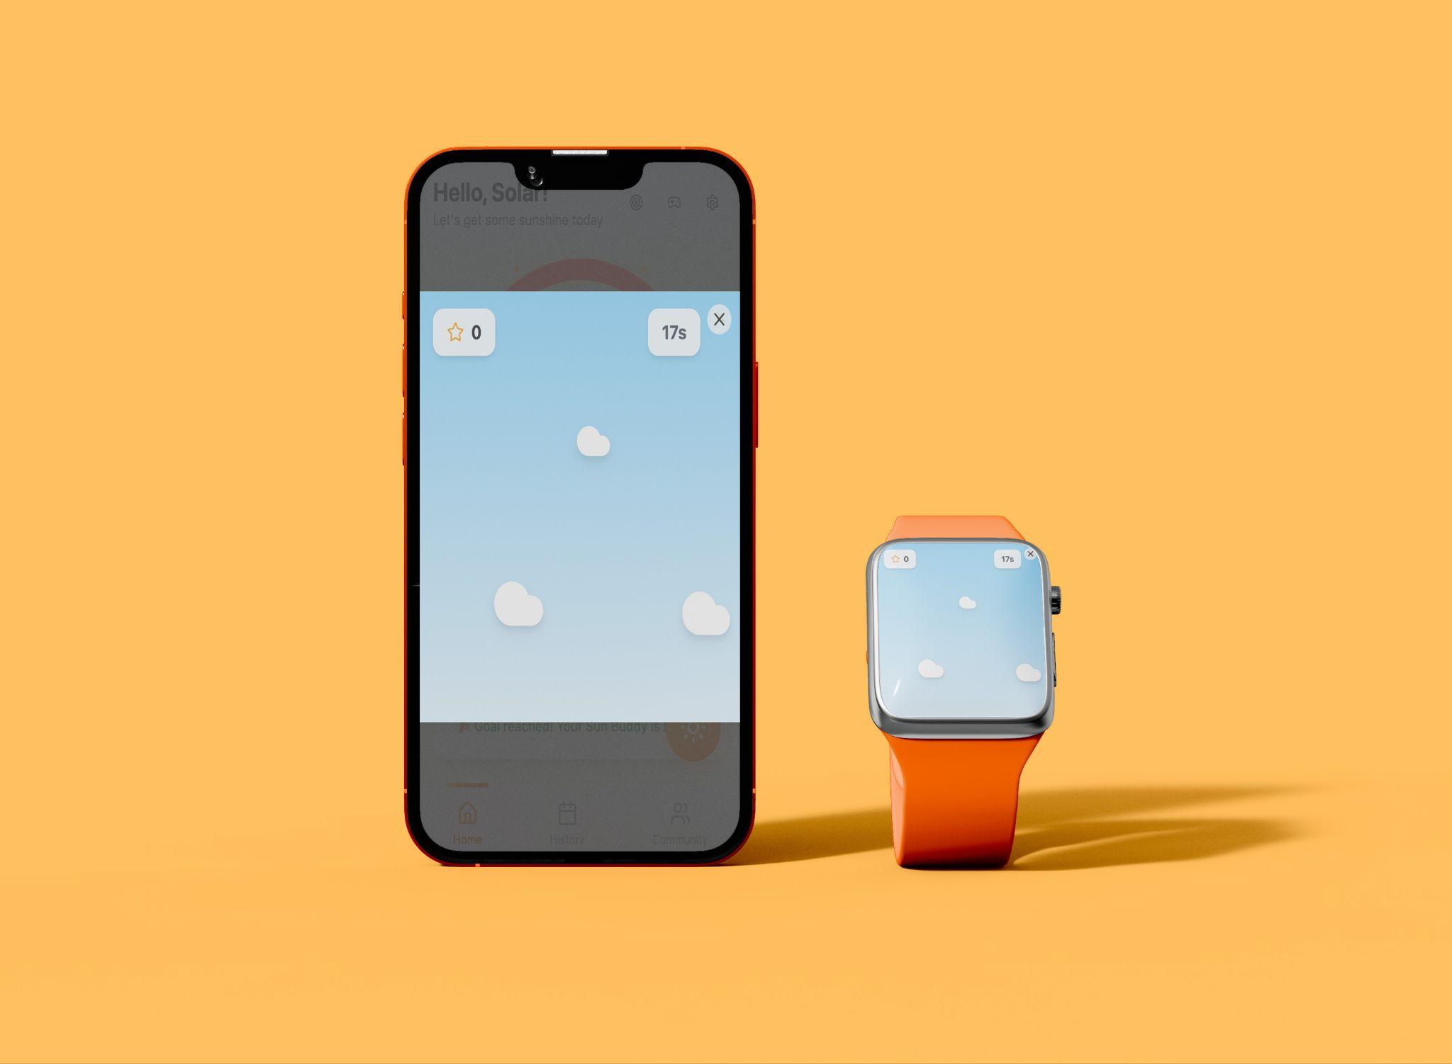
Interactive Gameplay
Notes:
Caitlyn

Slide 10
Customized Sun Buddies!!! (~5)
https://sun-buddy-tracker.base44.app/Home
Notes:
Sadie: Interaction with Crowd
CJ: Operating Sun Buddy Customization

Slide 11
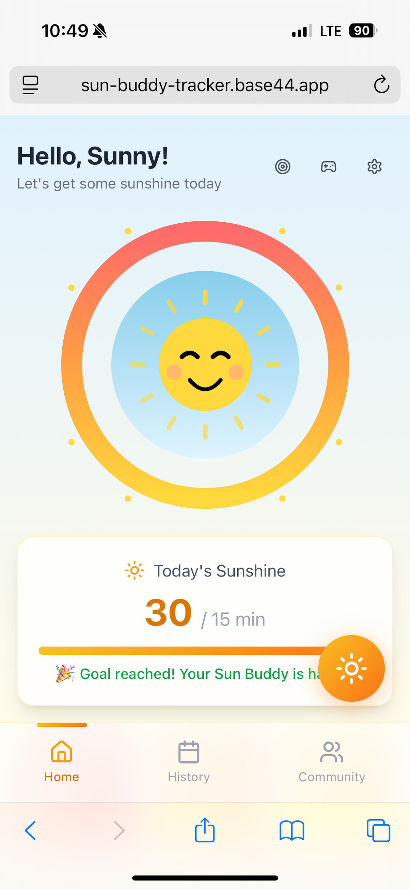
Refined Avatar (Sun Buddy)
Meet Sola and Sol!
Why Sol and Sola?
Notes:
CJ: Avatar Customization

Slide 12
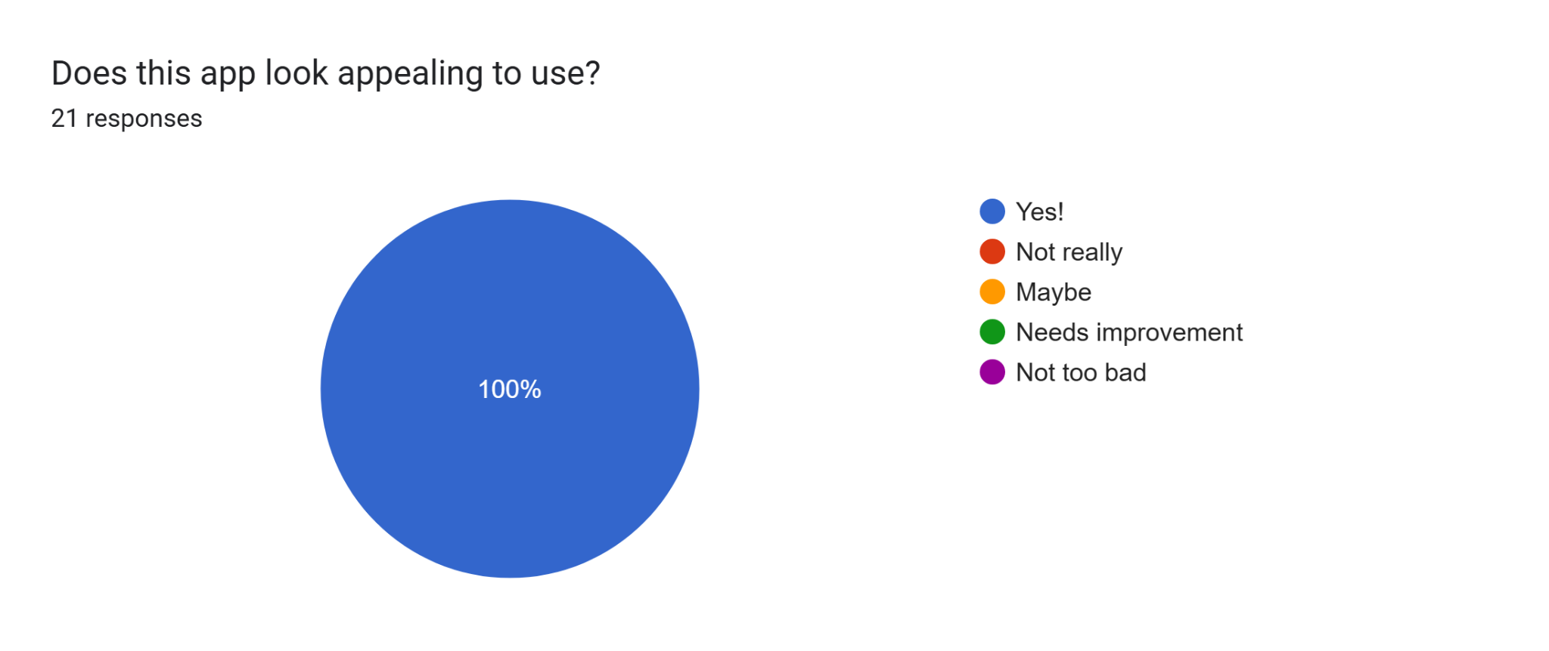
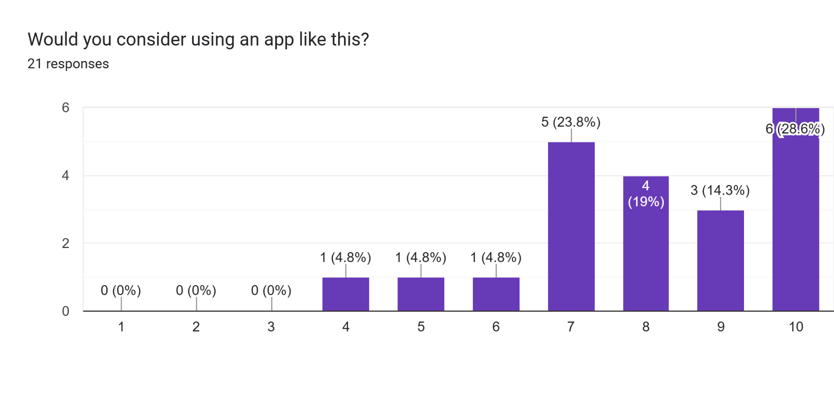
Testing

Slide 13
Confirmed Data
Pros:
“It looks simple, can be used with friends and it has a health purpose.”
“Cute, and appealing to look at, had information about benefits to sunlight, I thought that was a good idea.”
“Community portion is awesome, I like the opportunities to get sunshine together.”
Cons:
“I don’t know how much of this I can correlate to my health and it may not be considered something important for most people.”
“...Can you set the app to your specific location? So it’s relevant to sun exposure? (For example, if you live in Alaska, that sun exposure will look different than Arizona)”
“Doesn't have a strong incentive to hit the goal everyday. The app also can't tell if you were actually outside.”
Notes:
Sharlie:
CJ:

Slide 14
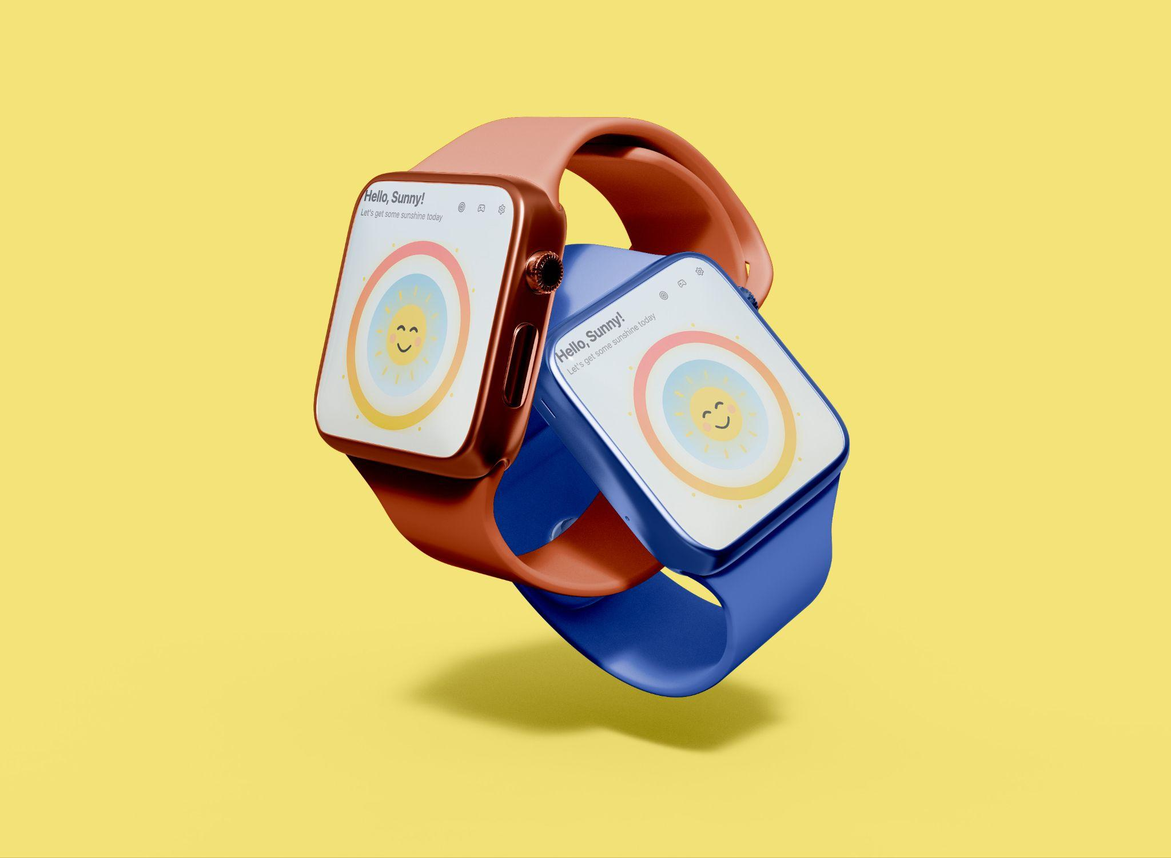

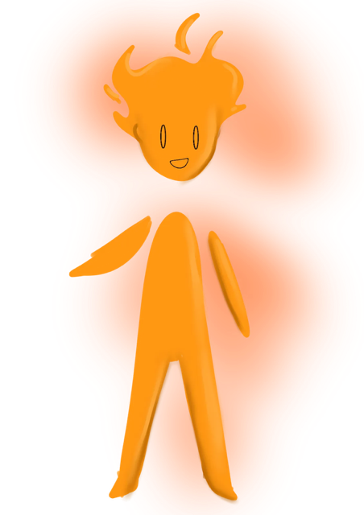
Moving Forward (~1)
Advertisement to make this a fully functioning app (pay people)
Greater development of features
Connect with Apple watch (API call)
Notes:
Sophia: API Call
Caitlyn: Greater Development Plan > Segway to Conclusion

Slide 15

Conclusion
Sun Buddy logo
Open up to Q&A
Notes:
Jaselyn: Summary and Segway to Q&A

